Slide 1
Predicting “Illogical” Weather Condition
by Logical Ways
----WeatherAUS Database Research

Slide 2
Worried about the Weather?
Travel Plan

Slide 3
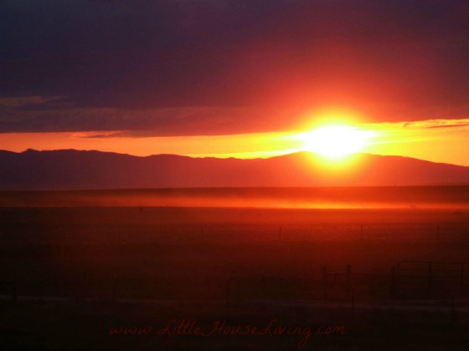
Old Fashioned Ways to Predict The Weather
Cloud Predictions:
Check out the shapes and height of the Clouds.
Animals Predictions:
Check out the animals behaviors.
Sky Predictions:
Check out the color and weather phenomena.

Slide 4
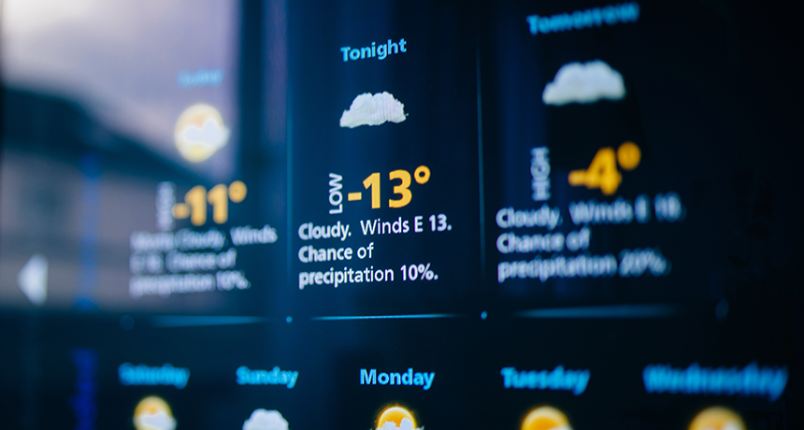
HELLO!
We are
Min Jiang
Fangzheng Hu
Kaibin Ye
Yaoshitu Ma
Yun Lei

Slide 5
Research Question
Predict whether it will rain tomorrow.
Question: Is rainfall a random walk?

Slide 6
Today’s Agenda
Data Intro and Data Cleaning
Autoregression
Prediction
Conclusion

Slide 7
Data Intro and Data Cleaning
Data introduction, Dealing with the Outlier and Correlation among variables analysis.
1

Slide 8
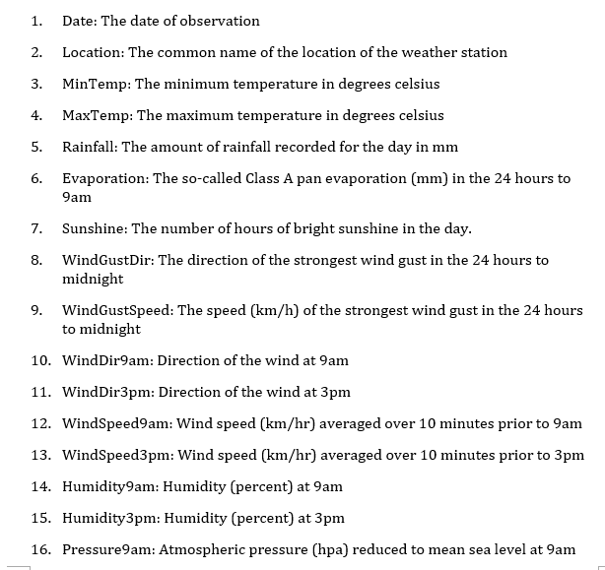
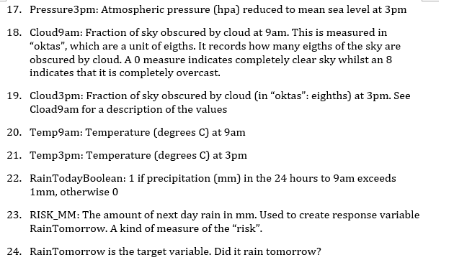
Data Introduction

Slide 9
Missing value treatment
Evaporation 42.78903%
Sunshine 47.69292%
Cloud9am 37.7353316%
Cloud3pm 40.1524688%
( Missing value)
142,193 112,925

Slide 10
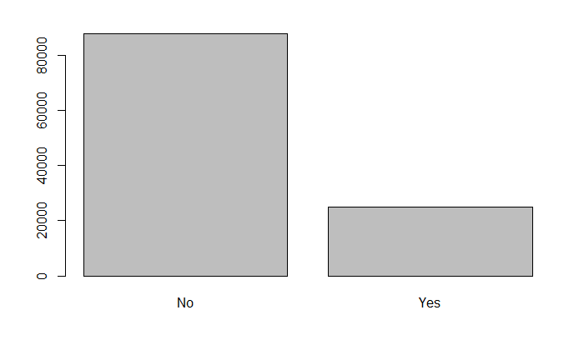
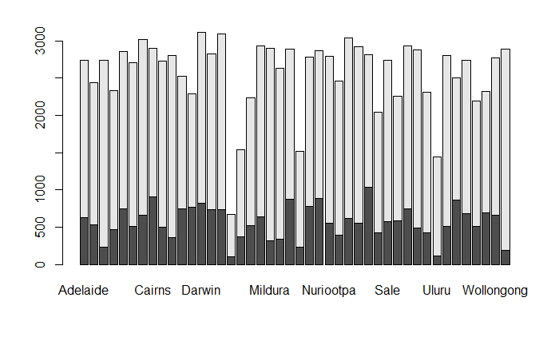
Check Whether Samples are Balanced

Slide 11
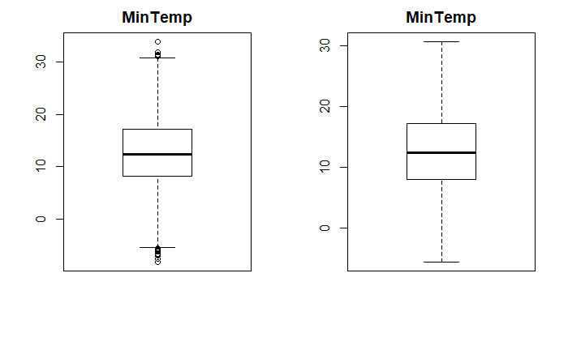
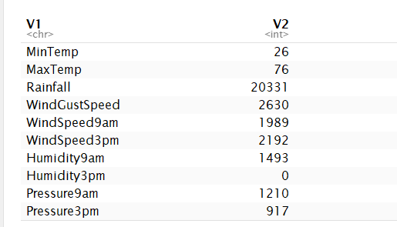
Outliers Treatment

Slide 12
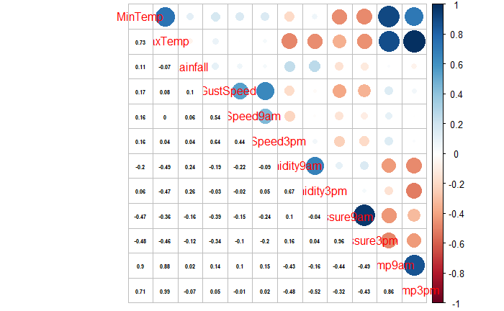
Correlation Among Variables

Slide 13
Autoregression
2

Slide 14
Autoregression
Is the rainfall random walk? or We could predict it base on historical data
We apply the AR(1) for the Rainfall in all 44 cities.
Ljung-Box Test to test whether the AR(1) model is good fit at 10% significance level
23 cities fit into AR(1) model while 23 cities do not.

Slide 15
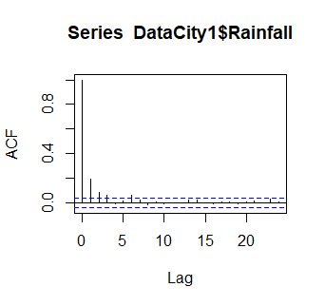
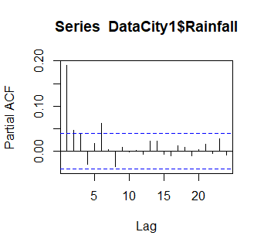
Autoregression

Slide 16
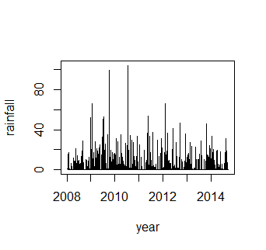
Autoregression
Take Albury as an example
Y_{t}= 0.41Y_{t-1}-0.115Y_{t-2}-0.227ε²_{t-1}+0.0289 ε²_{t-2}+0.0642ε²_{t-6}+ σ²
L-jung Box Testing
χ-suqare=7.5563 with P-value = 0.0003516
5 days Prediction
[Pred.] 1.588683 1.829298 1.945867 2.008247 2.016820
[S.E.] 6.573764 6.678447 6.702354 6.705681 6.706123

Slide 17
Prediction
Predict based on characteristics of different area.
3

Slide 18
Linear Regression
Rainfall as the output cannot be negative.
The linear regression is not the appropriate model

Slide 19
Deal with Unbalanced Samples Using Bagging
Testing Dataset
30%
Training Dataset
501 models vote

Slide 20
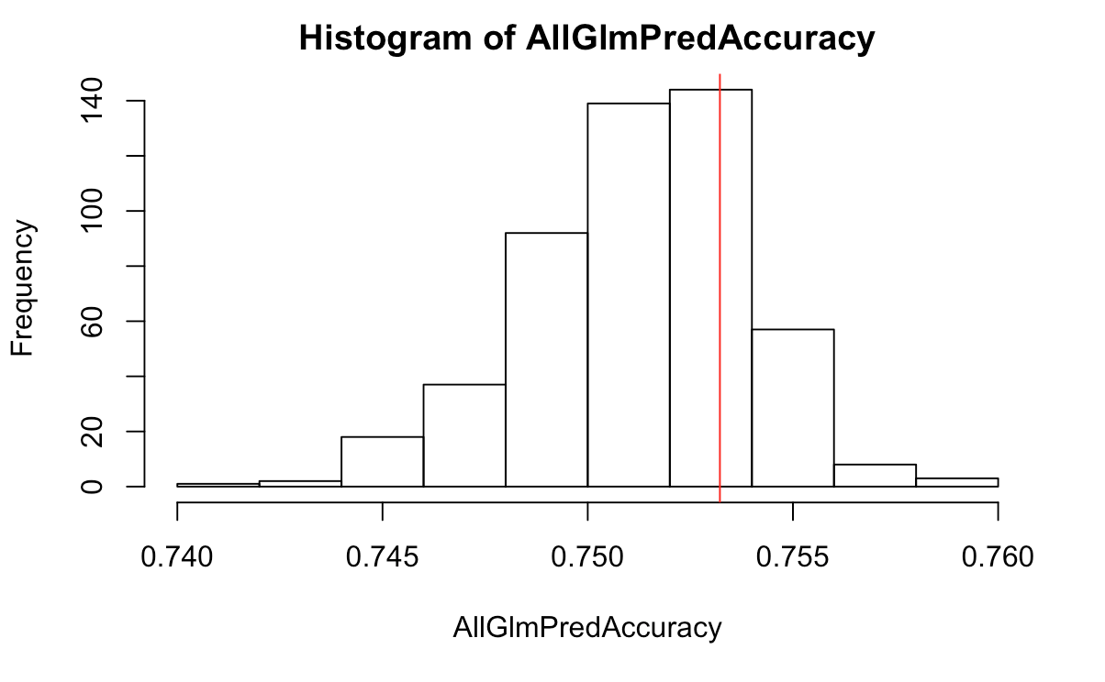
Logistic Regression
Bagging achieves the average accuracy of all the logistic regressions

Slide 21
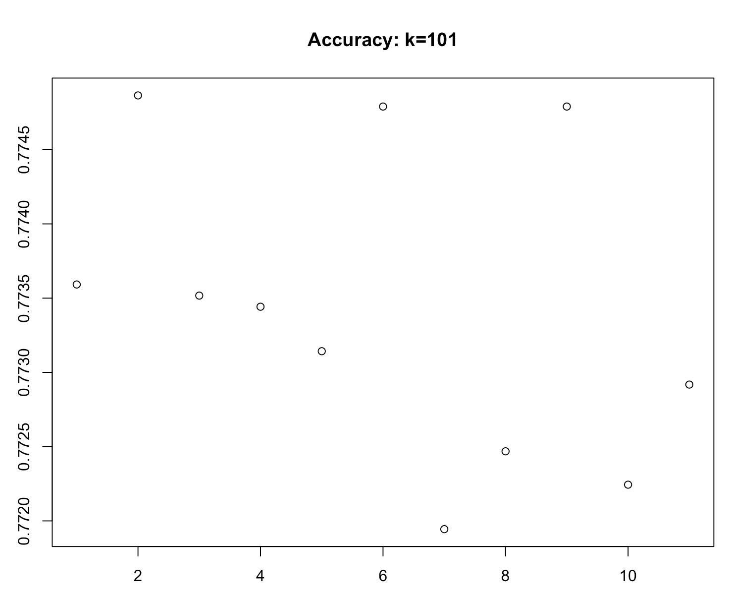
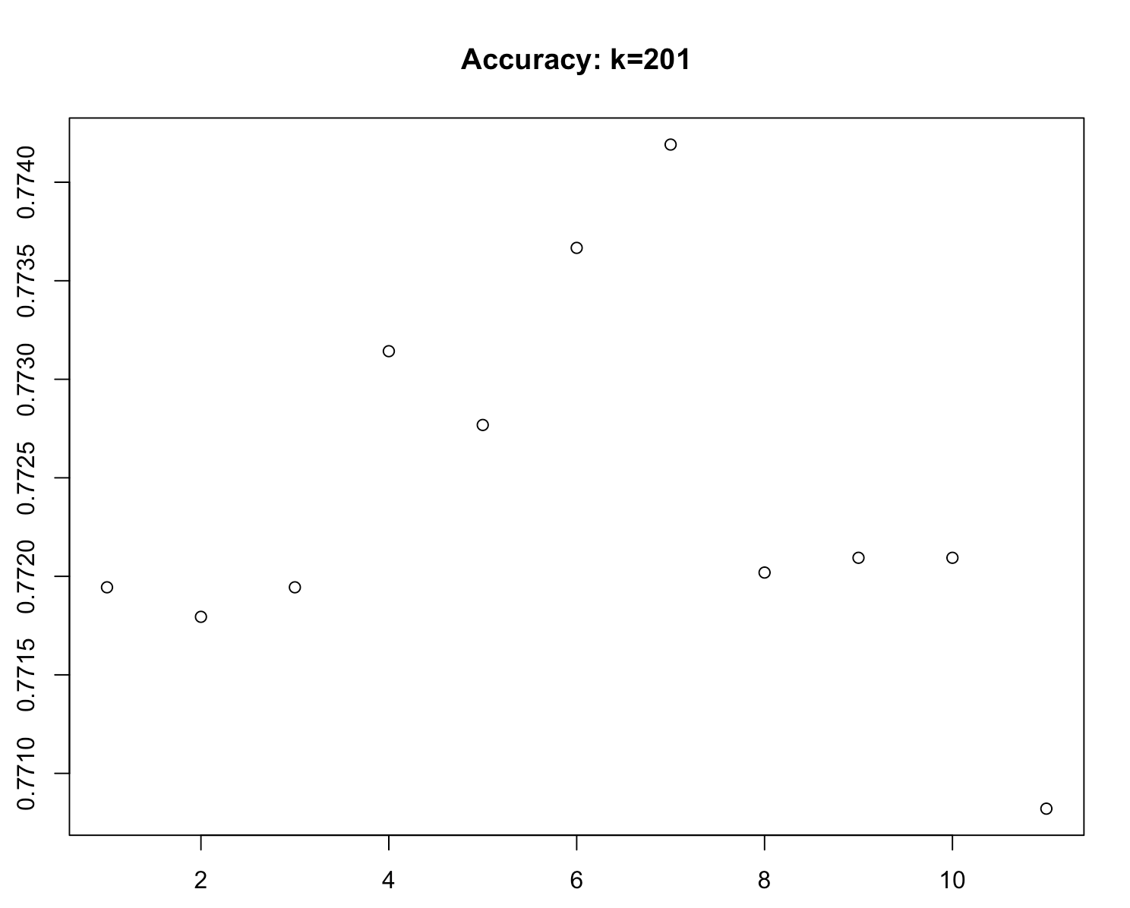
KNN
The accuracy is very stable, roughly 77%

Slide 22
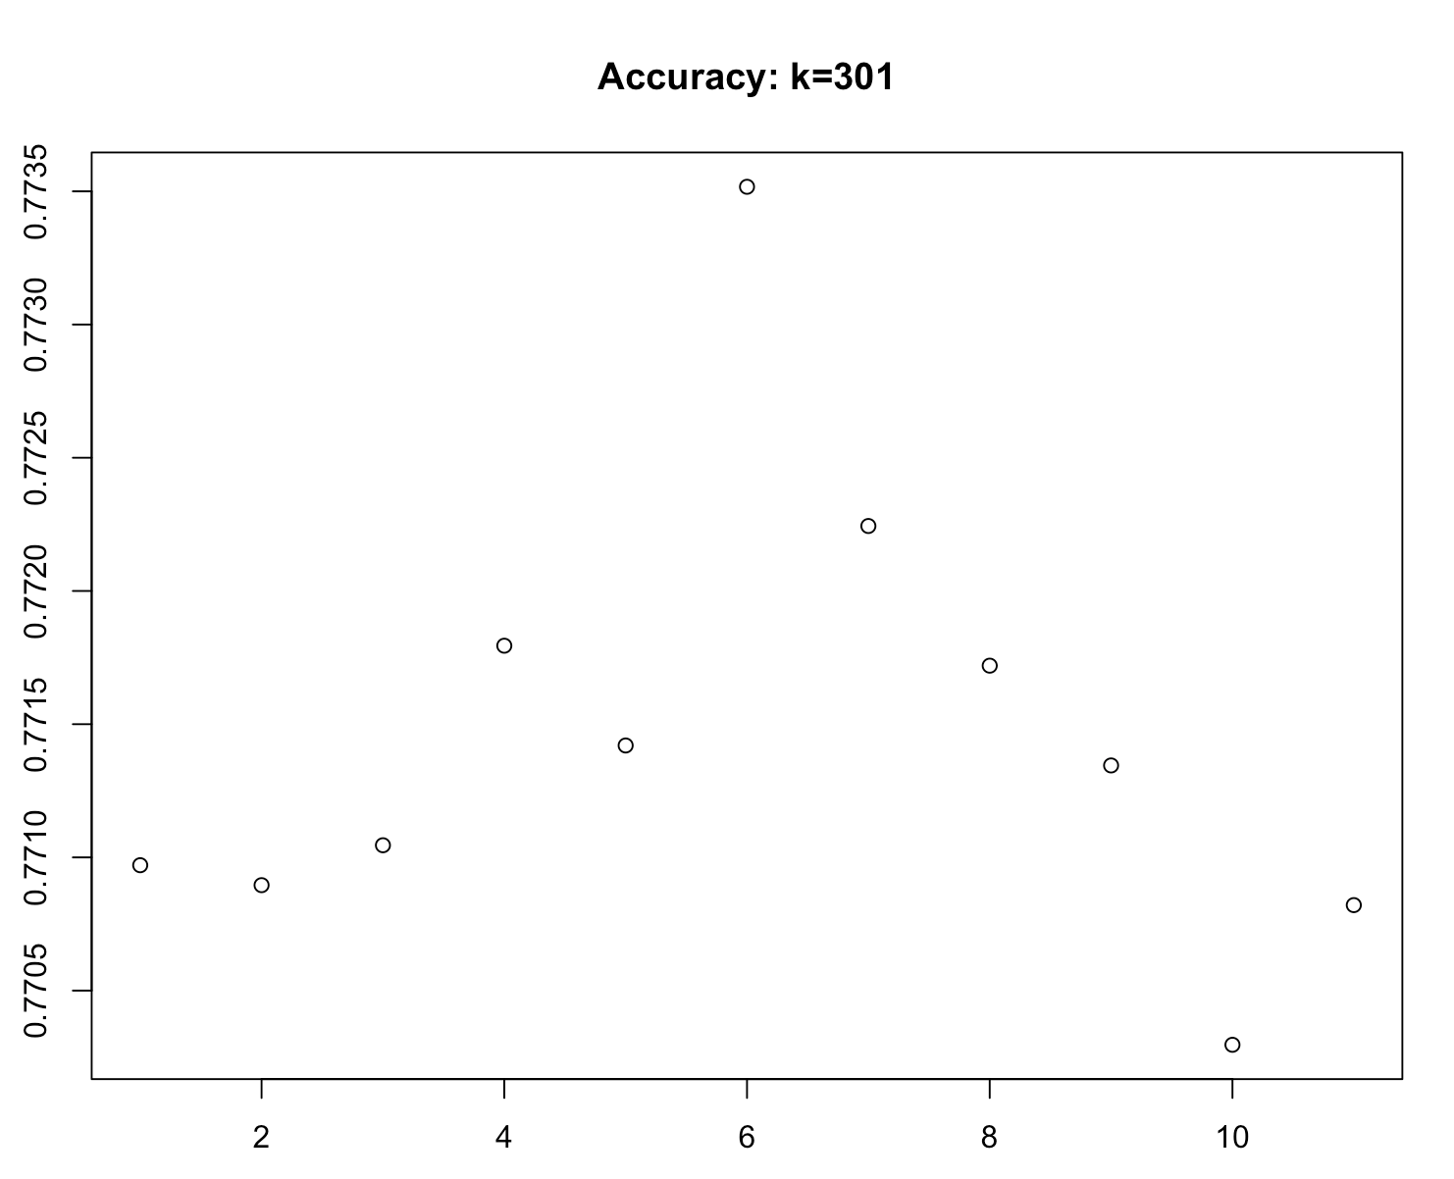
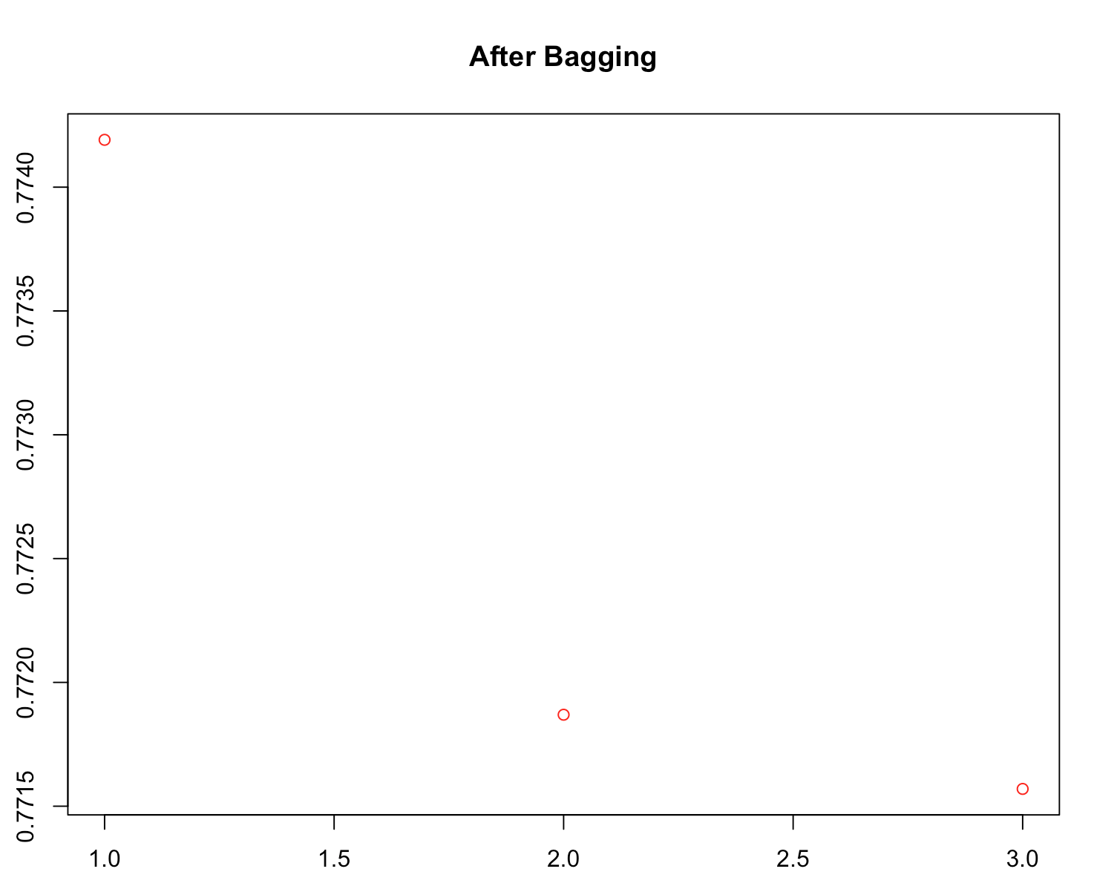
KNN
Different knns are very similar to each other

Slide 23
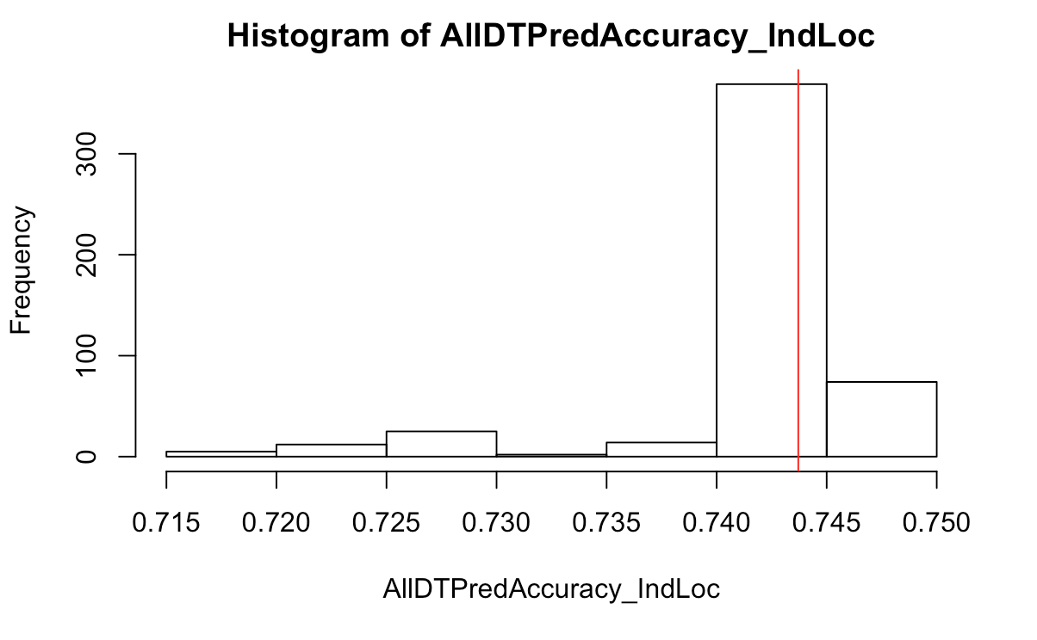
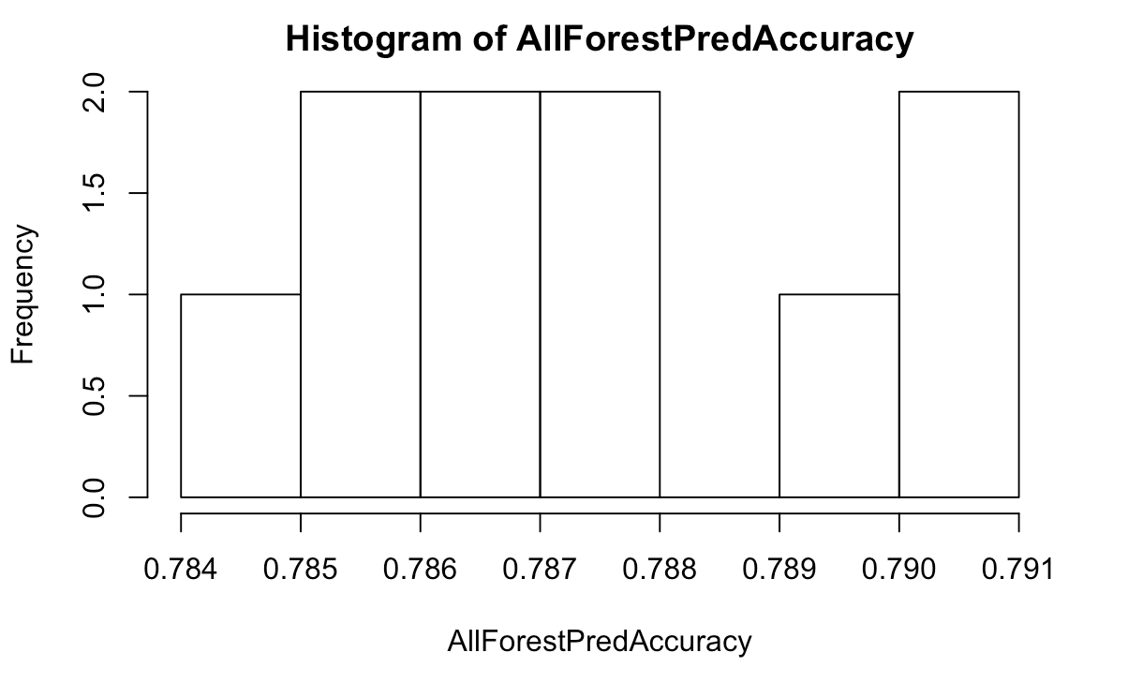
Decisions Tree and Random Forest
VS
Random Forest wins!

Slide 24
Conclusion
Key conclusion based on analysis and Key takeaway from the project.
Weather conditions in the past may be effective - Autoregression
Random Forest achieves the highest prediction accuracy
Bagging achieves more stable prediction accuracy than a single model
4

Slide 25
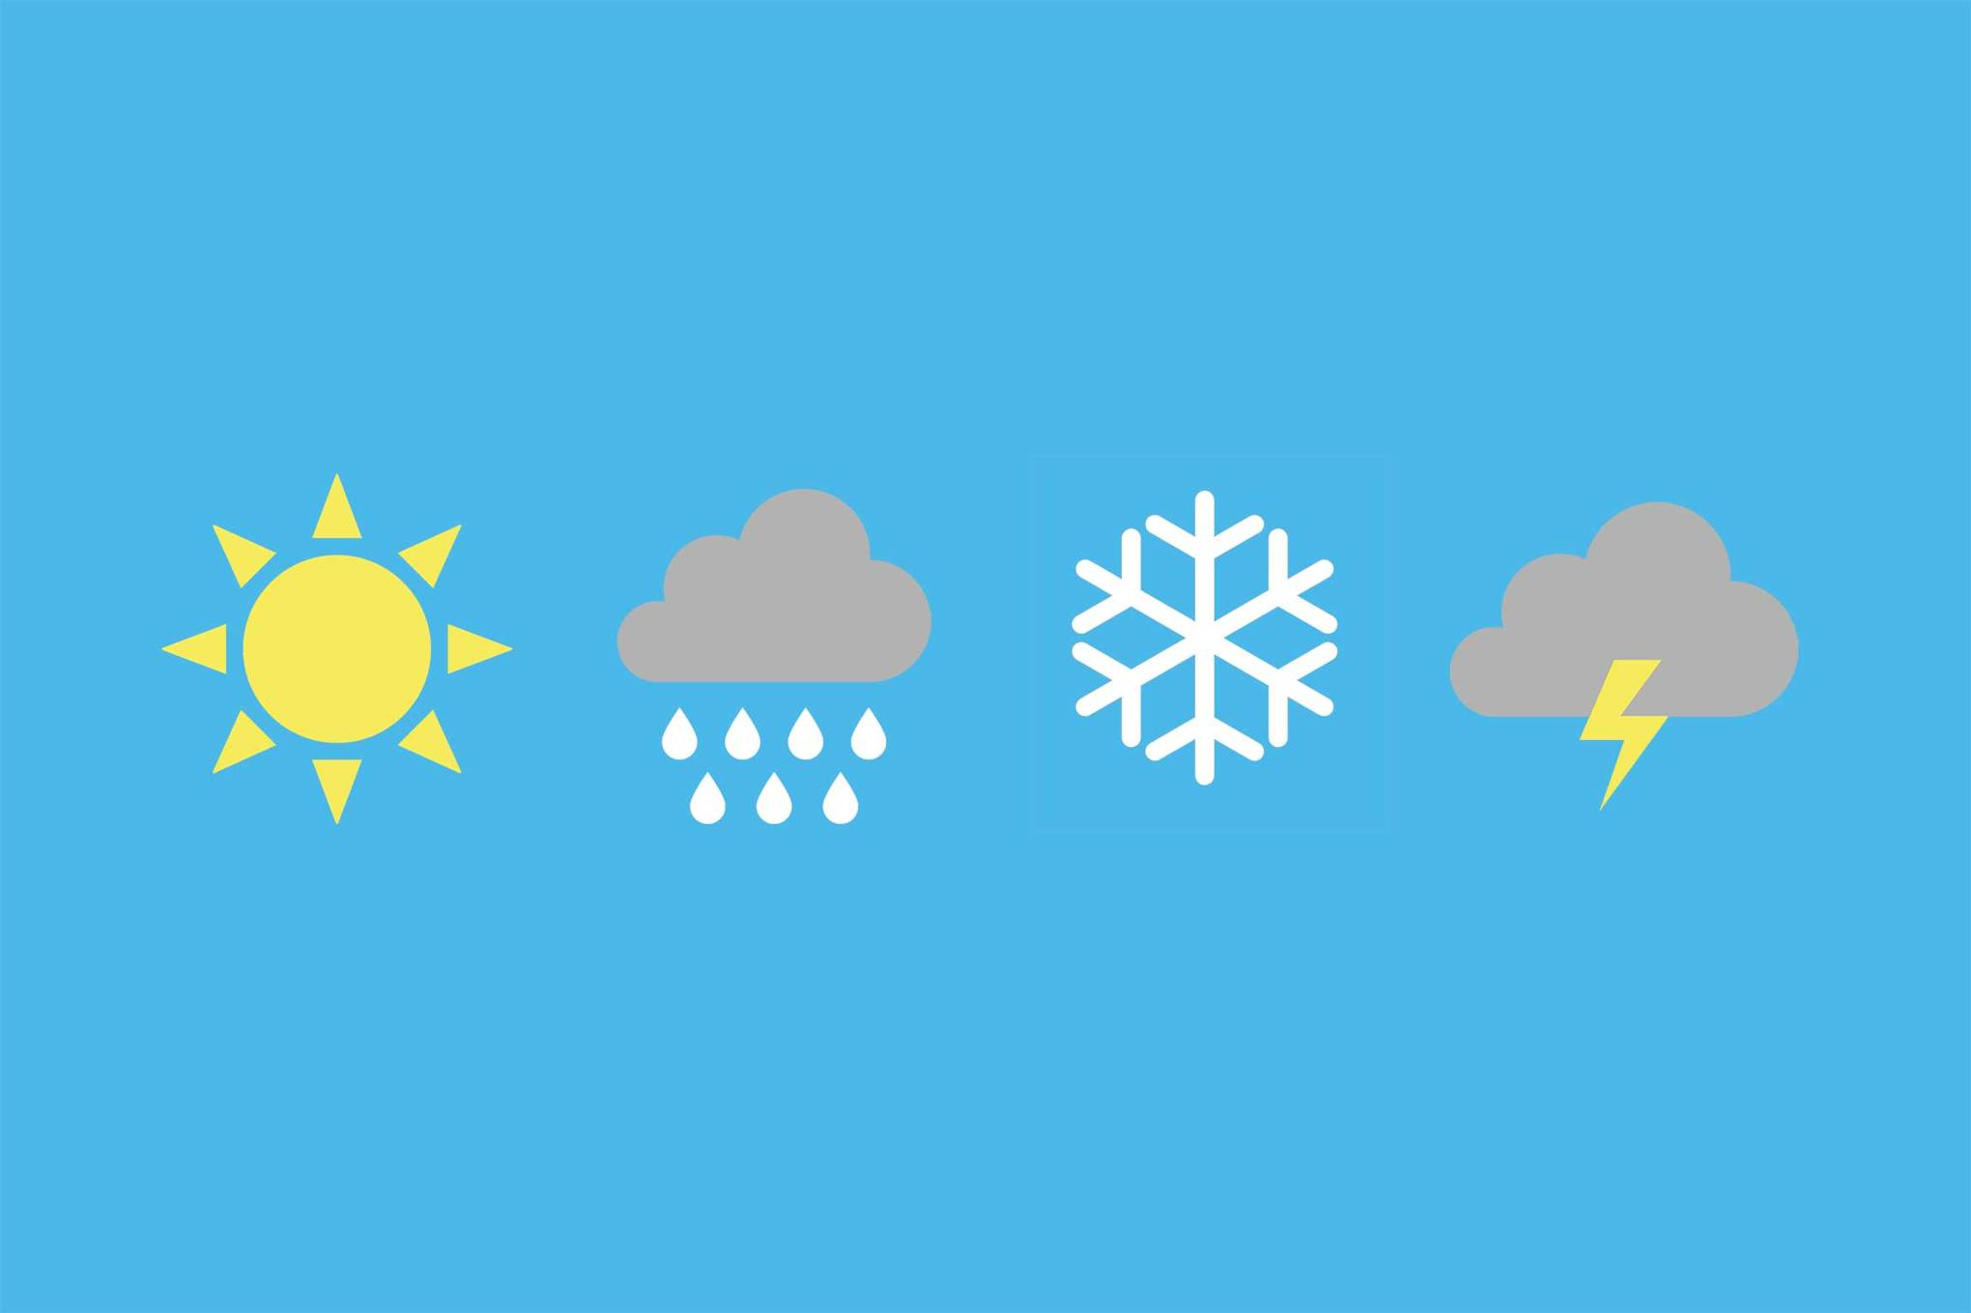
THANKS!
Any questions?

